Slide 1
WELCOME TO IQCS CERTIFICATION PRIVATE LIMITED (INDIA)
(Mark Of Trust)
Management System Register
Building Relation World wide

Slide 2
About IQCS India.
IQCS India is one of the fastest growing conformity assessment body compliance with ISO 17021:2015 & accredited by Multiple International Accreditation boards. IQCS India is having experienced professionals, helping organizations to achieve excellence and world class competitiveness through the application of standalone or integrated national and International standards certifications
IQCS India accredited certificates are recognized world wide which helps organization to get global recognition for their product/services.

Slide 3
Our Vision
Is to be recognized globally as partner of choice for third party accredited certification and audit services in entire sector including manufacturing, process, services, in infrastructure personnel and product certification.

Slide 4
Our Services:
We provide certification and audit services to the Quality Management System ISO 9001, Environment Management System ISO 14001,Food Safety Management System ISO 22000, Occupational Health and Safety Management System OHSAS 18001 and CE MARKING.IQCS India is also accredited for various management system training programs which also includes accredited six sigma green belt & black belt courses.

Slide 5
IQCS India Mission:
Understanding and finding solution to your strategic challenges through a tailored approach and effective evaluation is the cornerstones of IQCS India. By focusing on the relationship between your business goals and operational process, Risk based certification, helps you to mitigate risk, increase your ability to meet objectives, and enhanced stakeholders trust in your company.
IQCS India takes a true partnership approach to certification. You Provide input on which operational processes are most crucial to your business success.

Slide 6
IQCS India A Commitment To Excellence
In IQCS India, employees go through one of the most stringent training and qualification programs in the business. Our auditor speaks your langauge and know your local needs, customs and market. They know the business you are in and are trained to understand the challenges you face.

Slide 7
Registration Services:
Quality Management System (ISO 9001:2015)
Environment Management System (ISO 14001:2015)
Food Safety Management System (ISO 22000:2005)/HACCP
Information Security Management System (ISO 27001:2005)
Occupation Health Management System(OHSAS 18001:2007)
CE Marking
Third Party Inspection Services
Welder Qualification & Personnel Certifications.

Slide 8
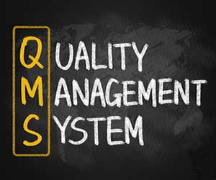
Quality Management System: (ISO 9001 :2015)
ISO 9001:2015 is an international standard. It is one of the most widely known and internationally accepted models for a quality system, and the basis of many highly effective quality systems. The standard can be applied to any size of company or organization, any industry and any country, for both services and products. The standard itself consists of set of requirements specify what a company must do, but not how to do it.
ISO 9001:2015 QMS certification enables you to demonstrates your commitment to quality and customer satisfaction, as well as continously improving your quality systems and integrating the realities of a changing world.

Slide 9
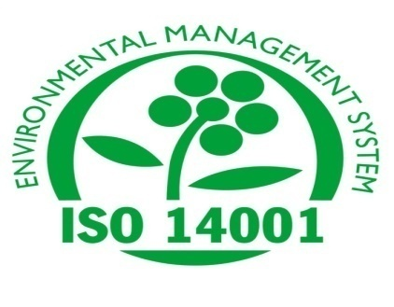
Environmental Management System:(ISO 14001:2015)
ISO 14001:2015 Provides guidance on how to manage the environment aspect of business activities more effectively, while taking into consideration environment protection, pollution prevention and socio-economic needs.
ISO 14001:2015 Environment Management System Certification enables to demonstrates commitment to the environment, as well as continuously improving corporate image and integrating the realities of changing world.

Slide 10
Food Safety Management System:(ISO 22000:2005)
ISO 22000:2005 Food Safety Management System- requirement for any organization in the food chain, it is an international standard which defines the requirements of food safety management System Covering all organizations in the food chain, including catering and packaging companies. Key elements of the standard include:
Interactive communication
System management
Control of food hazard through pre-requiste programs and
HACCP plans, Continual improvement and updating of the management system.

Slide 11
Occupational Health & Safety management System (OHSAS 18001:2007)
OHSAS 18001 is an assessment specification for Occupational Health and Safety Management System.
It enables organization to manage operation risk and improve performance. It also provides guidance on how to manage the health and safety aspects of business activities more effectively, while taking into careful consideration accident prevention, risk reduction and well-being of employees.

Slide 12
CE Marking:
CE making was introduced by the European commission in 1985 and it is the Commission who also set the condition for use of the CE mark within the different CE mark directives. With the CE marking, the manufacturer or his representative within the EU declare that the individual product is in compliance with the general safety regulation in the CE marking directives.

Slide 13
IQCS with ASCB(Europe) UK Accreditation
ASCB(E) is independent, impartial and a paradigm pioneer in the field of accreditation.
Operating in over 25 countries world wide, ASCB(E) is thought to be the largest independent accreditation body in the world. Established in 1995, The organization has been a president pioneer in the field of accreditation.

Slide 14
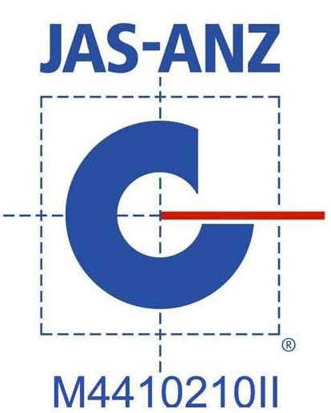
IQCS with JAS-ANZ Australia & New Zealand Accreditation
JAS-ANZ is the government appointed accreditation body for Australia and New Zealand responsible for providing accreditation of conformity assessment bodies(CABs) in the field of certification and inspection.
JAS-ANZ is a member of International Accreditation Forum (IAF) & signatory to a number of bilateral, regional and international agreements.

Slide 15
IQCS With DAC Dubai Accreditation
DAC is Dubai Accreditation Center part of government of Dubai-Dubai Municipality with the member of International Accreditation Forum (IAF)

Slide 16
THANK YOU…..

